Slide 1

cv
Phase II - Review 2
IDENTIFICATION OF CORN LEAF DISEASES BASED ON CONVOLUTIONAL NEURAL NETWORK
Batch No.: 22
Team Members:
1. Ramachandra - 1DS19CS124
2. Sushil Kumar A M - 1DS19CS175
3. Siddesh Patten Shetty - 1DS19CS157
4. Sourabh Chandrashekar Gaonkar- 1DS19CS163
Under the Guidance of
Dr. Rohini T V
Associate Professor, Department of Computer Science and Engineering
Department of Computer Science & Engineering, DSCE

Slide 2
INTRODUCTION TO THE PROBLEM
Plant disease is a major problem in agriculture, which is an important factor of the economic growth of the country. Plant diseases have a catastrophic effect on food safety and can lead to reductions in both the quantity and the quality of agricultural components. Corn diseases are caused by a various factors, including pests, climatic change, and disease severity. Leaf disease is one of the most serious diseases that affect corn crops, reducing food production and food nutritive values. Corn leaves display a wide range of symptoms, such as grey leaf spots, common rust, northern leaf blight, and brown spots. These diseases can be identified using deep learning techniques. Deep neural networks are used in deep learning to process classification of data, pattern discovery, and feature extraction.
Department of Computer Science & Engineering, DSCE

Slide 3
CONTRIBUTION OF EACH PROJECT MEMBER
RAMACHANDRA Building a CNN model. Preparation of Implementation paper. | SUSHIL KUMAR A M Model builing. Preparation of Implementation paper.
SIDDESH PATTAN SHETTY GUI design Preparation of Presentation. | SAURABH CHANDRASHEKAR GAONKAR GUI design. Preparation of Presentation.
Ramachandra: Model Building
Sushil Kumar A M:
Siddesh Pattan Shetty:
Sourabh Chandrashekar Gaonkar:
Department of Computer Science & Engineering, DSCE

Slide 4
System Requirement Specification
Hardware Requirement:
Processor: Intel Core I5
RAM:8 GB
Hard disk : 1 GB
Software Requirements:
Operating System: Windows 7 or more
Software : VS code, Google Colab
Coding language: Python, HTML, CSS, JavaScript,
Framework : Flask
Department of Computer Science & Engineering, DSCE

Slide 5
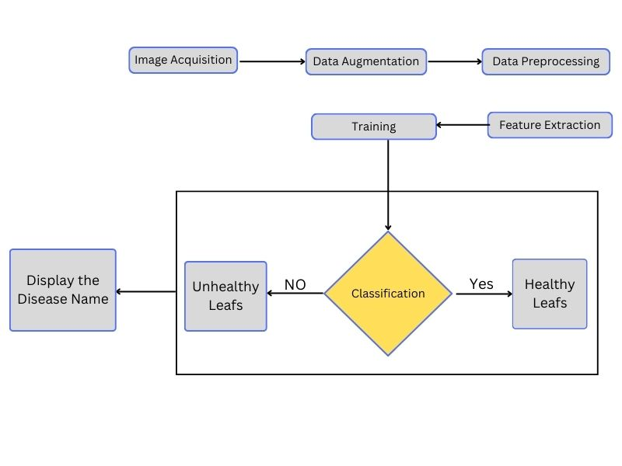
SYSTEM DESIGN
Fig 1. System design of proposed methodology
Department of Computer Science & Engineering, DSCE

Slide 6
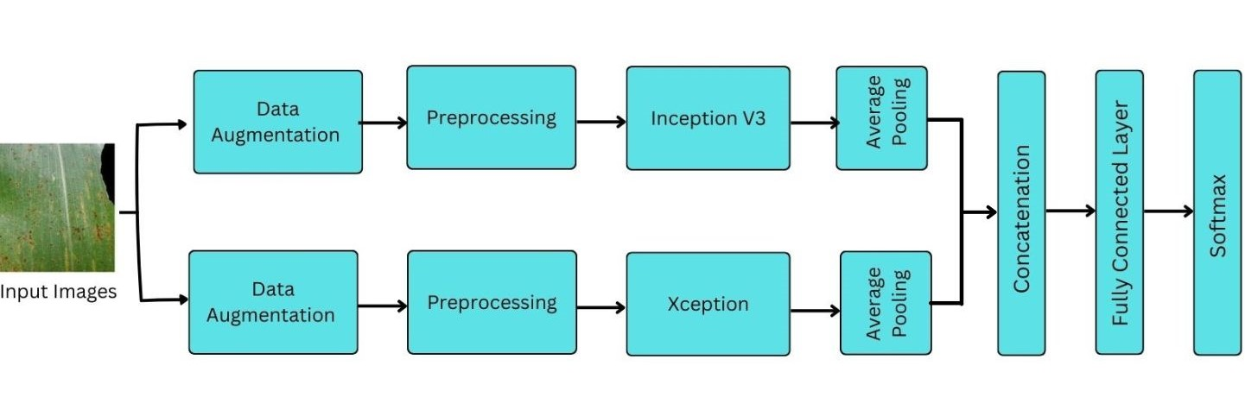
SYSTEM IMPLEMENTATION
Fig 2. Architecture of proposed CNN model
Department of Computer Science & Engineering, DSCE

Slide 7
SYSTEM IMPLEMENTATION
Algorithm for proposed CNN model.
Step 1 : Start
Step 2 : Image acquisition will be carried out and load leaf image as RGB format. Contrast image gives accuracy of affected image by using data augmentation.
Step 3: pre-processing
Step 4: Extract the features using feature extraction techniques like one hot encoding
Step 5: Classification of the images into healthy or unhealthy leaves.
Step 6: Concatenate the 2 models using ensemble technique.
Step 7: Display the name of the disease
Step 6: End
Department of Computer Science & Engineering, DSCE

Slide 8
MODULES
Image acquisition: This is the act of procuring an image from sources. This can be done via hardware systems such as cameras or directly input the images from the local storage.
Data Augmentation: Data augmentation is a technique of artificially increasing the training set by creating modified copies of a dataset using existing data. In our project we have used 2 technique to increase the data points.
• Geometric transformations: Randomly flip, crop, rotate, stretch, and zoom images.
• Color space transformations: Randomly change RGB color channels, contrast, and brightness
Department of Computer Science & Engineering, DSCE

Slide 9
MODULES
III. Pre-Processing:
Algorithm for data pre-processing:
Step 1: Start
Step 2: Getting the dataset
Step 3: Importing the necessary libraries
Step 4: Removing the unwanted data using KLib
Step 5: Encoding categorical data
Step 6: Splitting dataset into training and testing set.
Step 7: End
Department of Computer Science & Engineering, DSCE

Slide 10
MODULES
III. Pre-Processing:
Getting the dataset: We used data sets from the Kaggle.
Importing libraries: Importing the necessary libraries like Pandas for EDA, Klib for EDA and data cleaning etc.
Remove the unwanted data: By using the Klib libraries we removed the unwanted data like null values, missing values etc.
Encoding Categorical Data: We used label encoding method for encoding values, it will convert values into the binary format like 0 and 1.
Splitting dataset into training and test set : By using Sklearn library split the data into train and test. With test size of 0.2.
Department of Computer Science & Engineering, DSCE

Slide 11
MODULES
IV. Feature extraction:
Feature extraction refers to the process of transforming raw data into numerical features this will increases the accuracy of learned models by extracting features from the input data. In our project we used One hot encoding it is a process of converting categorical data variables so they can be provided to machine learning algorithms to improve predictions.
Step 1: Start
Step 2: Identify the categorical variables in your dataset that you want to encode. Step 3: Create an empty dictionary to store the mapping of categories to binary vectors. Step 4: Iterate over each categorical variable
Extract the unique categories from the variable.
Iterate over the unique categories:
Step 6:5End
Department of Computer Science & Engineering, DSCE

Slide 12
MODULES
Classification:
Classification is the process of predict the correct label of a given input data, there are different CNN methods for classification. Here we used transfer learning methods and it used pre-trained models as a starting point for solving new, related problems.
For our project we selected InceptionV3 and Xception these are the keras application used to predict the correct outputs. After preprocessing and feature extraction we use inceptionV3 pre-trained models it fine-tunes a model on a large dataset of corn leaf images, and then modifies the model to include additional layers such as pooling layers, fully connected layers and softmax layers specific to the task of Identification of Corn Leaf Disease.
Department of Computer Science & Engineering, DSCE

Slide 13
System Testing
System testing is a type of software testing that evaluates the overall functionality and performance of a complete and fully integrated software solution. It tests if the system meets the specified requirements and if it is suitable for delivery to the end-users. the acceptance testing
Test Case No | Test case | Steps | Expected Result | Actual Output
1 | Launch a web browser. | Enter the URL of the website in the browser's address bar. Press the Enter key or click the "Go" button. Wait for the website to load. Verify that the website's home page is displayed. Check for any error messages or alerts displayed on the website. | Verify Index page is displaying properly. | Index page is displaying properly.
2. | Verify that the website content and images are loading correctly | Enter the URL of the website in the browser's address bar. Press the Enter key or click the "Go" button. Wait for the website to load. | Verify that the website's home page is displayed, and images are displayed correctly. | Website's home page is displayed, and images are displayed correctly.
Department of Computer Science & Engineering, DSCE

Slide 14
System Testing
3. | Verify model is producing correct output using valid image | Enter the URL of the website in the browser's address bar. Press the Enter key or click the "Go" button. Enter prediction page. Input a file and click on submit. | Verify that the model predicting proper output. | Model predict correct disease.
4. | Verify that camera is working in capture image page. | Enter the URL of the website in the browser's address bar. Press the Enter key or click the "Go" button. Enter prediction using camera page. | Verify that displaying the captured image. | Camera is working
Department of Computer Science & Engineering, DSCE

Slide 15
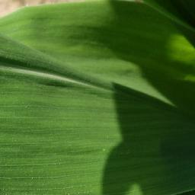
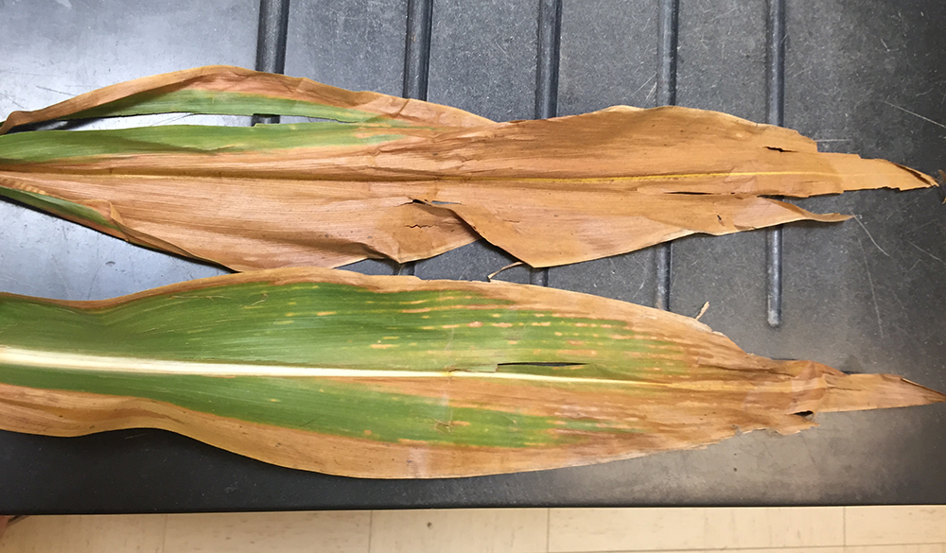
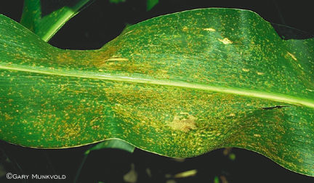
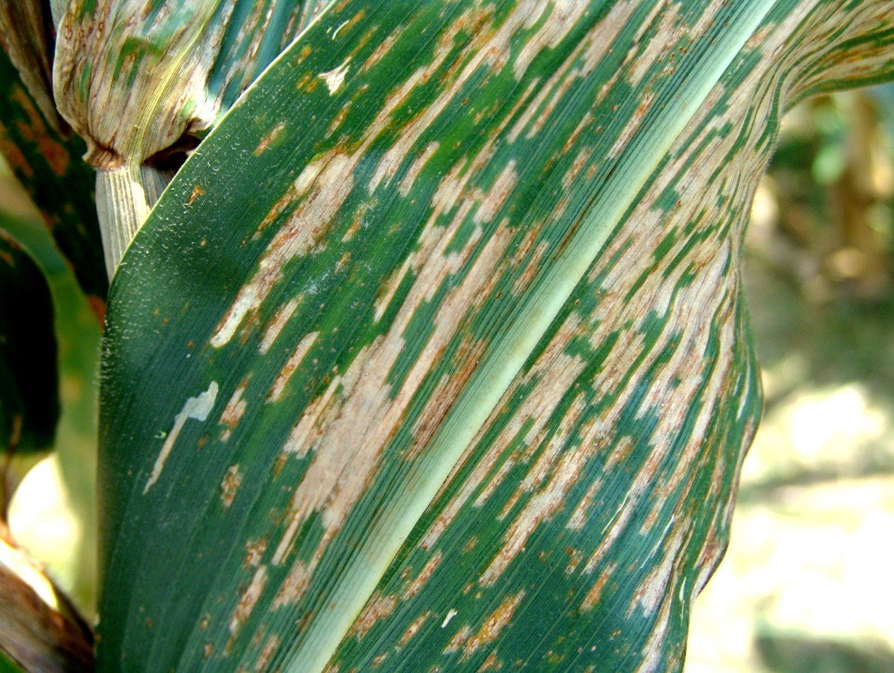
Screenshots
The dataset consists of healthy and unhealthy corn leaf images.
Healthy leaf
Corn Leaf Blight
Common Rust
Gray Leaf Spot
Department of Computer Science & Engineering, DSCE

Slide 16
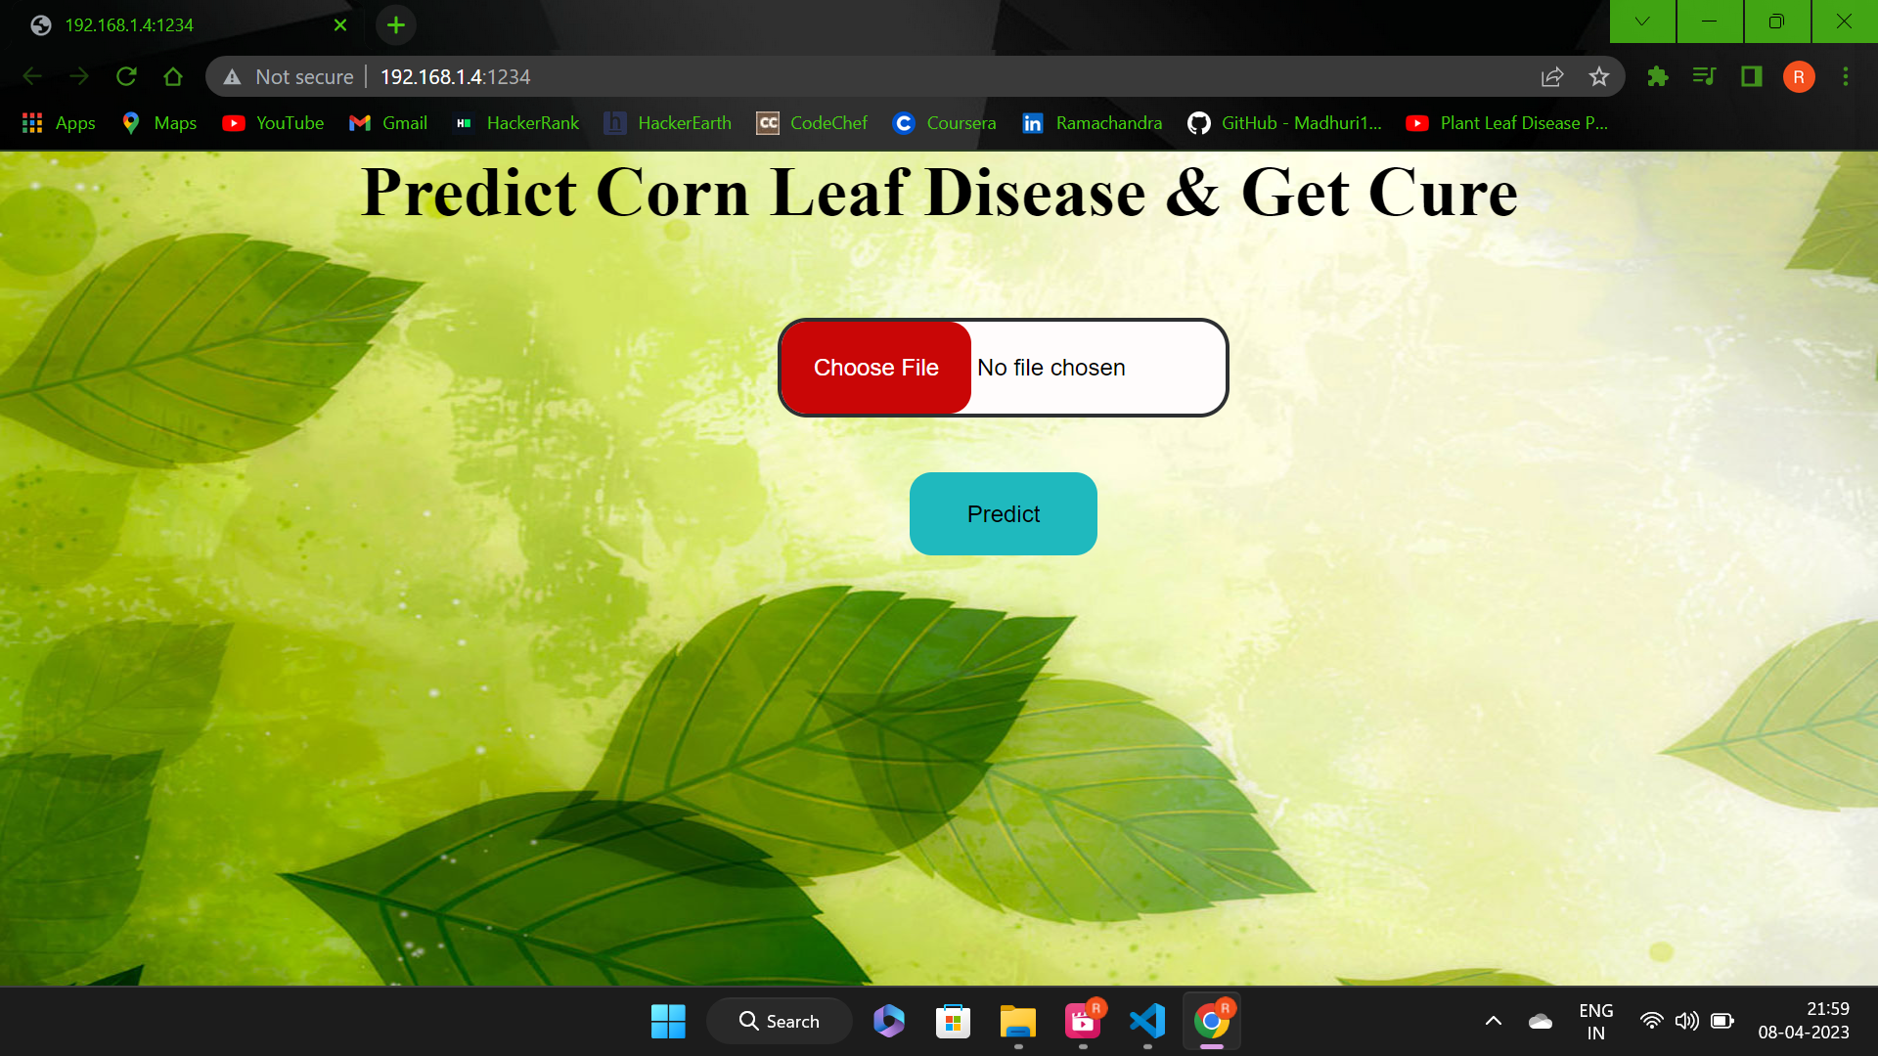
GUI DESIGN:
We have developed a website as the GUI of our project.
Department of Computer Science & Engineering, DSCE

Slide 17
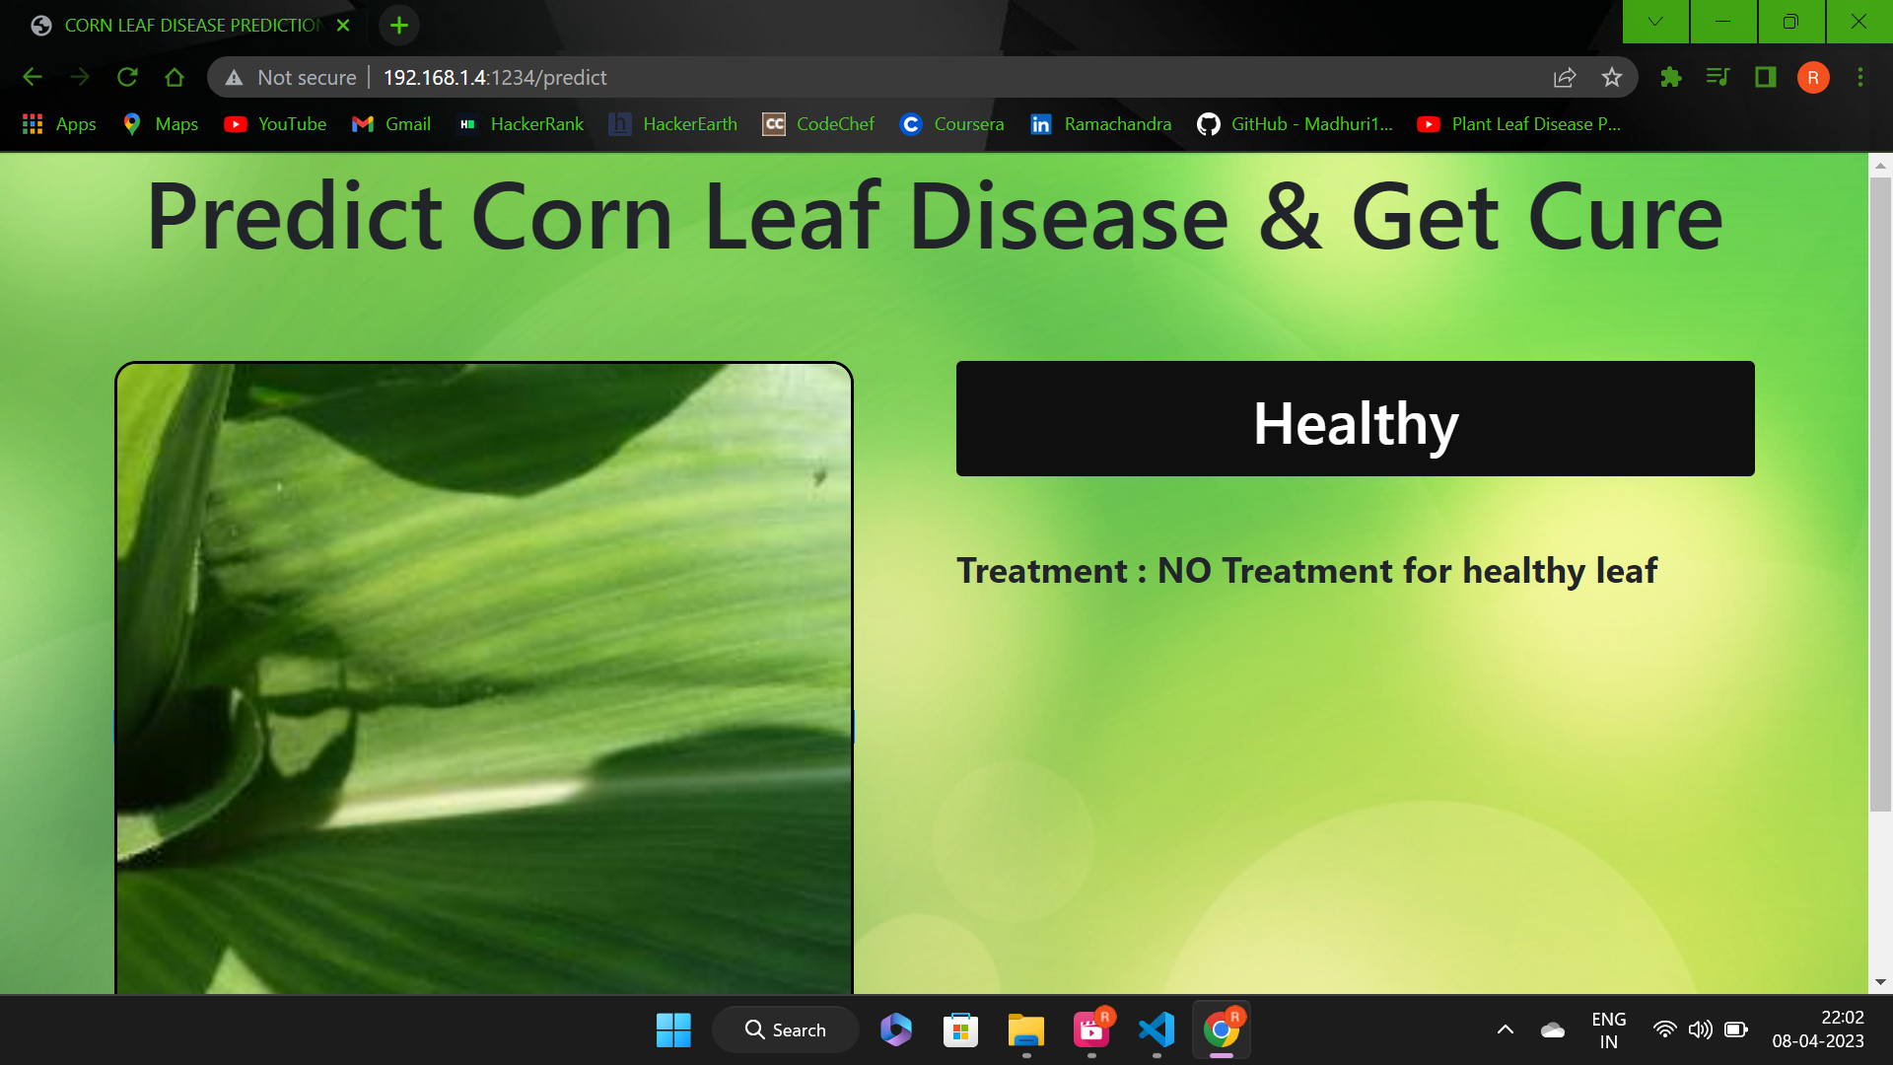
OUTPUT:
Department of Computer Science & Engineering, DSCE

Slide 18
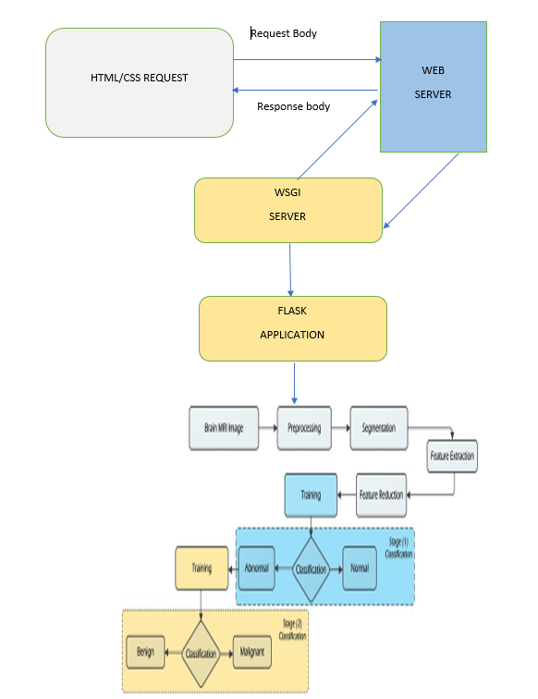
cv
CO-GUIDE MEET DETAILS
1st Meet :
Date : 14-Jan-2023
Suggestions/Improvements :
Gave insights about convolutional neural network and keras models.
2nd Meet :
Date : 18-Feb-2023
Suggestions/Improvements :
Reviewed the literature survey and helped with choosing the better model and gave insights about tools for frontend & backend development.
3rd Meet:
Date : 09-Apr-2023
Suggestions/Improvements :
Reviewed the project model and gave suggestions on integration of model with web tools.
Department of Computer Science & Engineering, DSCE

Slide 19
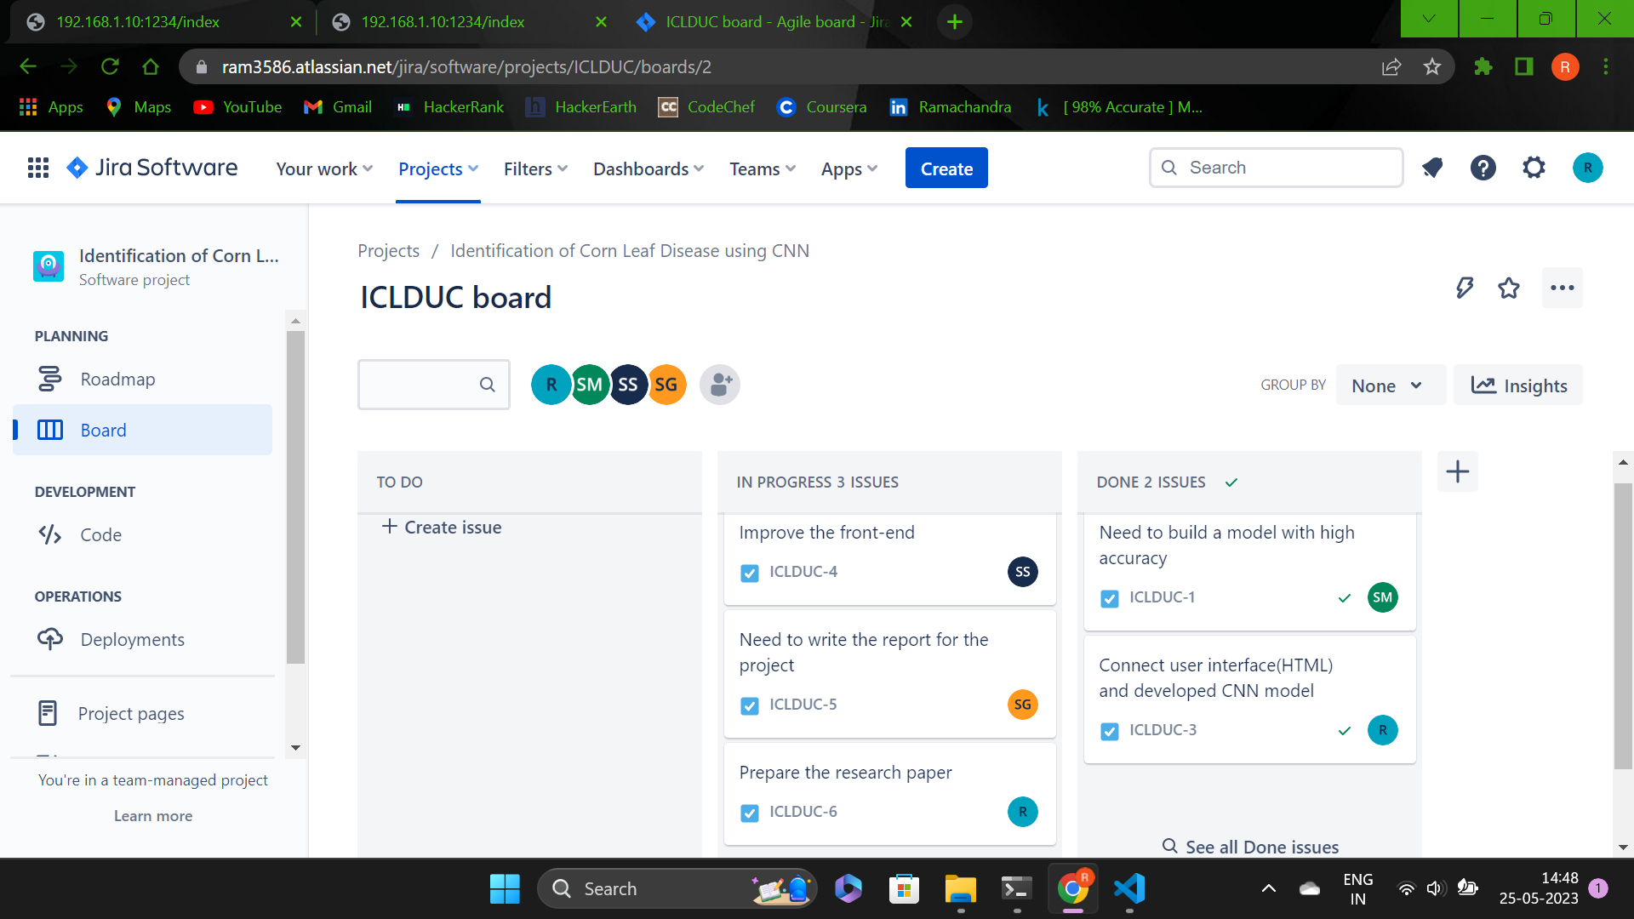
PROJECT TOOL SNAPSHOT:
Department of Computer Science & Engineering, DSCE

Slide 20
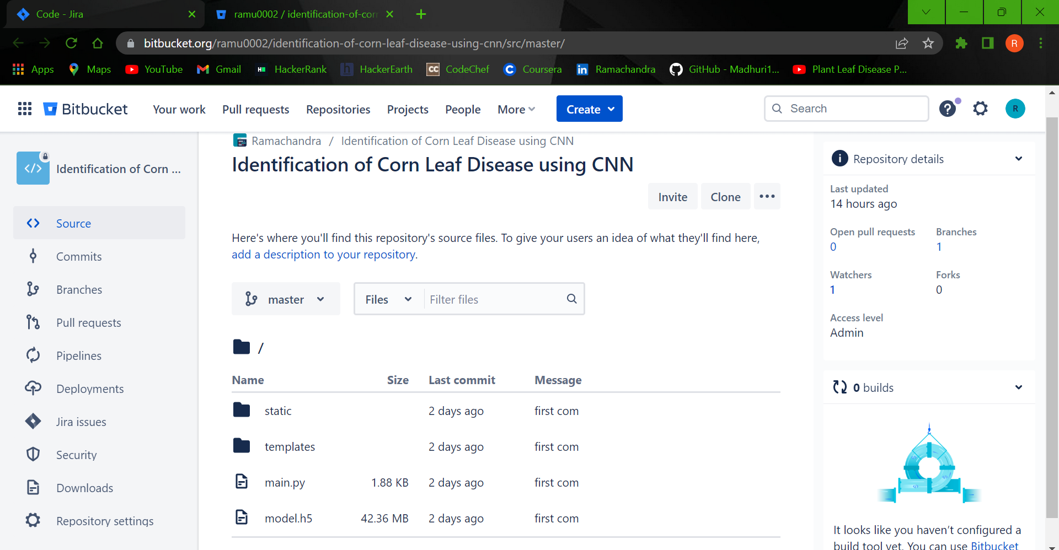
Department of Computer Science & Engineering, DSCE

Slide 21
Conclusion and Future Enhancement
Plant Diseases are major food threats that should have to overcome before it leads to further loss of the entire field. But, often framers unable to distinguish between similar symptoms but ace different diseases. This will mislead to wrong or overdosage of fertilizers. Here, we employ Convolutional Neural Network (CNN) called Deep Learning Algorithms to reduce this loss and guide farmers with video lessons. This can be done through mobile App "Not all farmers but some do use it."
• Agricultural department wants to Automate the detecting the yield crops form Eligibility process i.e. Real time Process.
• Automate this process to show the prediction result in web Application or Desktop Application.
• To optimize the work it should be Implemented in Artificial intelligence Environment.
Department of Computer Science & Engineering, DSCE

Slide 22
THANK YOU!
Department of Computer Science & Engineering, DSCE

